Slide 1
Tech Basics I
Stint - Movie library on Python Flask

Slide 2
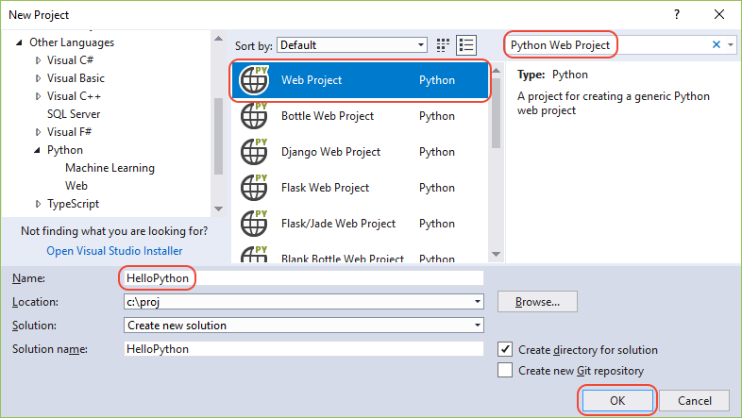
Get setting up
Install the Visual Studio and Install Python and Flask

Slide 3
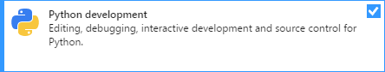
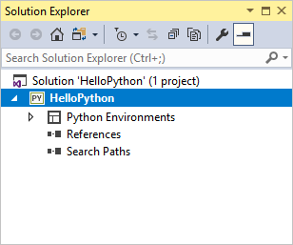
Get setting up
Install the VS and Install Python and Flask

Slide 4
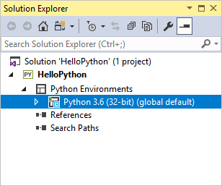
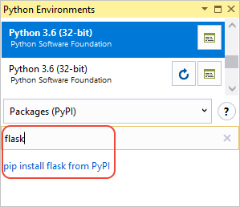
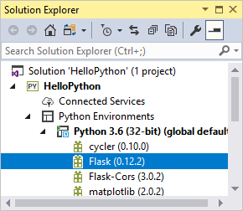
Get setting up
Install the VS and Install Python and Flask

Slide 5
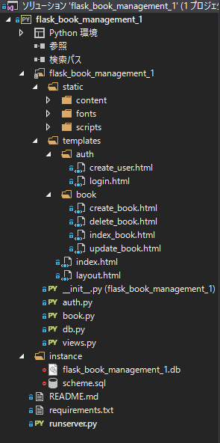
Get setting up
Create the frame
File structure of the to-be-finished project

Slide 6
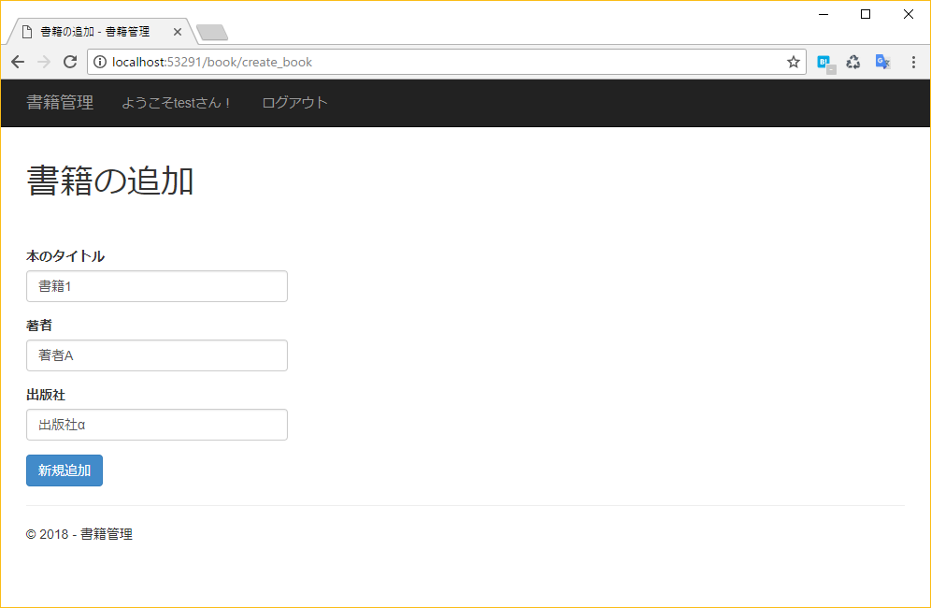
The application
Simple Functions
Adding a movie

Slide 7
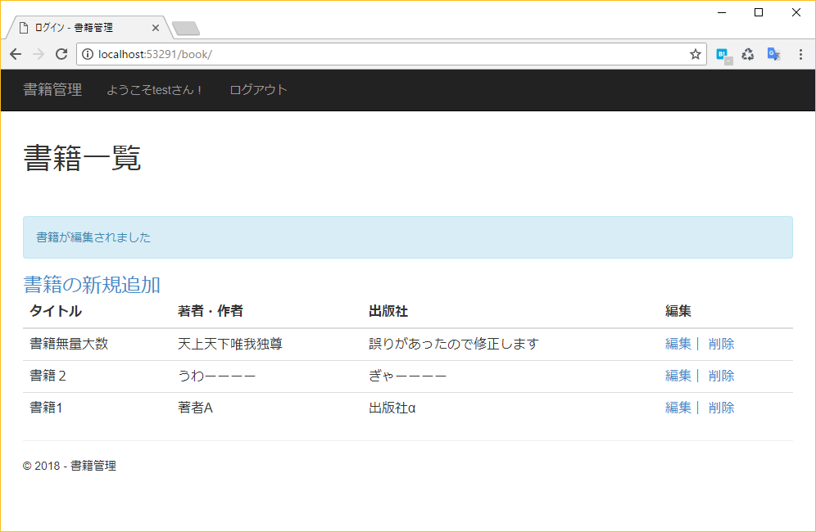
The application
Simple Functions
Movie detail report

Slide 8
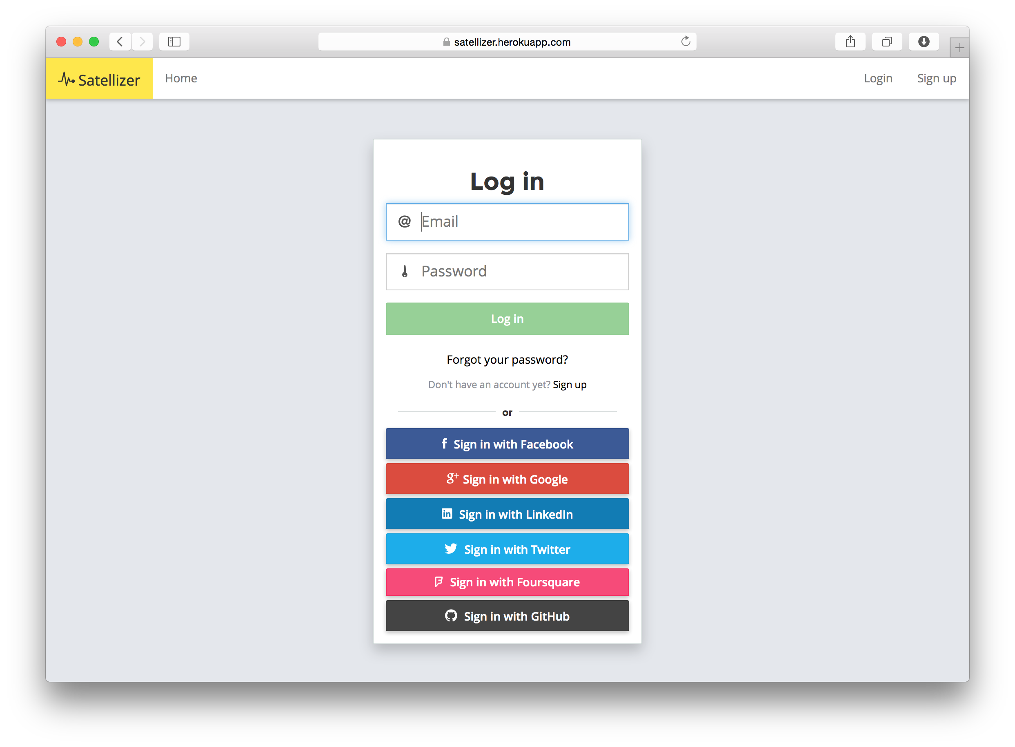
The application
Simple Functions
Login with Instagram for Interest look up and share

Slide 9
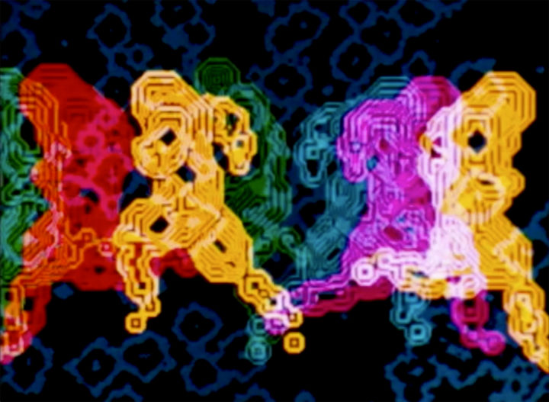
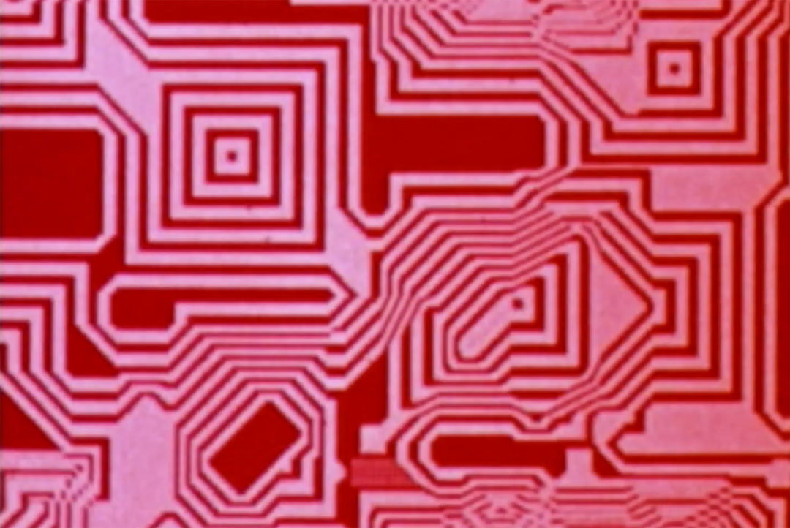
Amusements
Explore digital art
Select and blend digital art into the application.

Slide 10
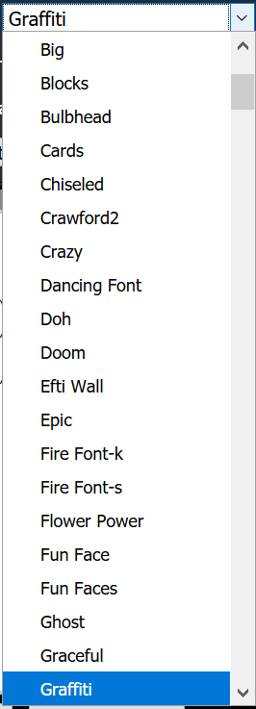
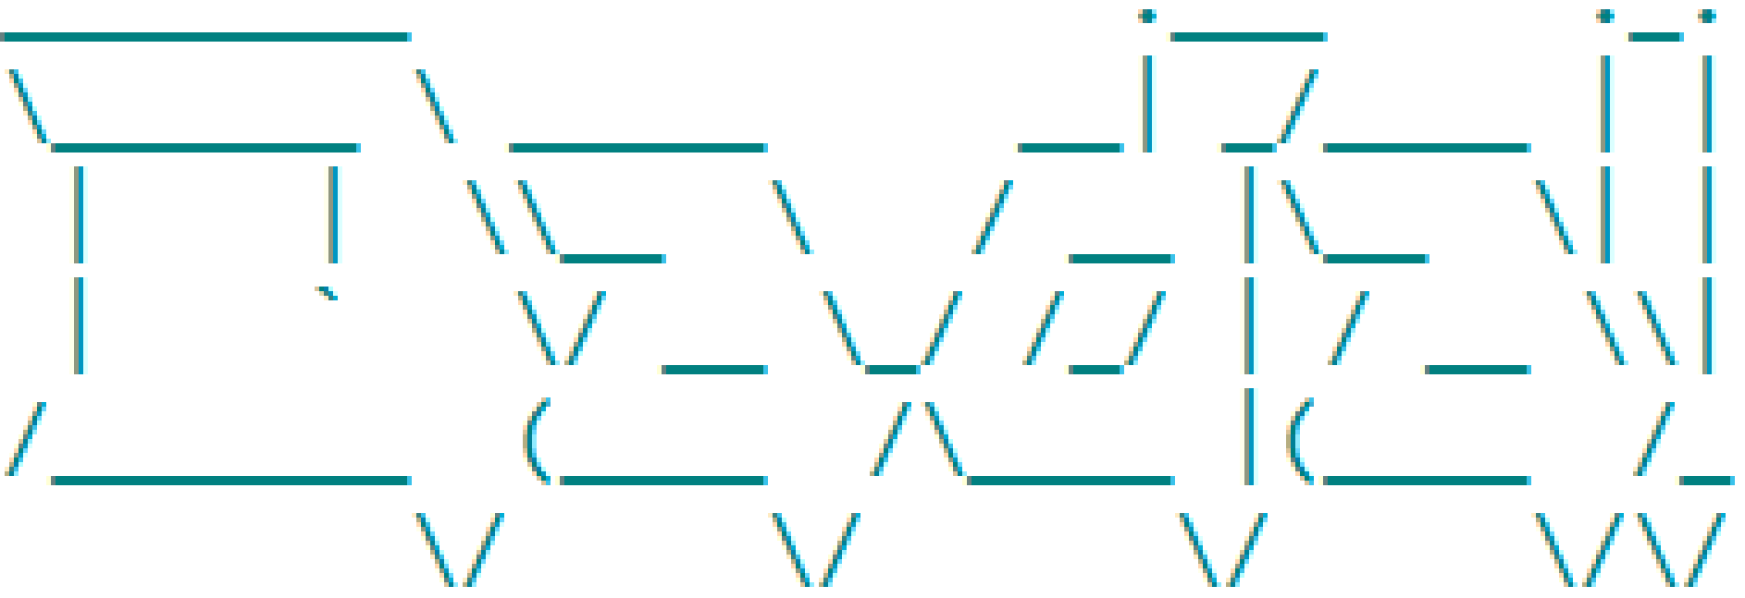
The application
Blend with ASCII art
Enrich the UI with ASCII art
Select Figlet fonts

Slide 11
Add a Slide Title - 3

